Slide 1
History of contextual representation
A brief overview of evolution of the Language representation

Slide 2
Understand our task
NLP Model
Text Summary
Text
Should Answer the Question based on the input text
There is 2 types in summary
Extractive - Gives most useful sentences from the text as it is as summary. Less challenges
Abstractive - Gives human lever interpretation of the text we provide. More challenges but interesting and demanding.

Slide 3
Pre-Training NLP
Word Embeddings are basis of NLP
King : [-0.5, -0.9, 1.4, …] Queen : [0.6 , -0.8, -0.2,..]
Word Embeddings(word2vec, GloVe) are often pre-trained on text corpus from using statistics.
The king wore a crown the queen wore a crown
Inner product
Inner product

Slide 4
Problem
Solution
The Embedding of words are in context free manner.
Open a bank account
On the river bank
[0.3,0.2,-0.8,...]
Train contextual representation on text corpus
[0.9,-0.2,1.6,..]
[-1.9, -0.4, 0.1,..]
Open a bank account
On the river bank

Slide 5
Evolution
Semi-Supervised Sequence Learning,Google
Instead of using conventional Pre-Trained embeddings they tried to train Entire model as Language Model.But with small corpus and small model
Improving Language Understanding by Generative Pre-Training, OpenAI
Trained 12-layer Deep Transformer LM, and fine-tuned on Classification Task
2017
2015
2018
ELMo: Deep Contextual Word Embeddings, AI2 & Uni. of Washington
Used Bigger model, trained bigger corpus.
Trained Bi-directional model (weak).
Basic Idea is it gives word embeddings which can be used in any existing SOTArt, and you get Next SOTArt

Slide 6
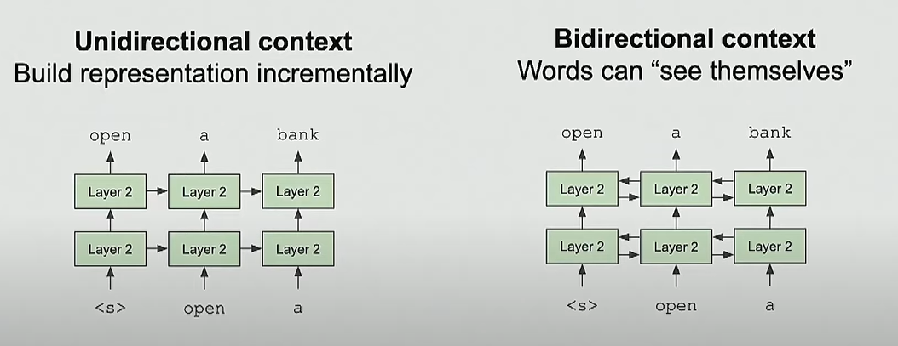
Problems with previous methods
Problem: Conventional Language models only use left context or right context, but language understanding is bidirectional.
Why Bidirectional?

Slide 7
Transformers
Empirical Advantages of Transformers vs. LSTM
Self-Attention == no locality bias
Long-distance context has equal opportunity
Single multiplication per layer == efficiency on TPU/GPUs
Effective Batch size is number of words, not sequences
Eg., Let’s say we have 500 words and 32 sentences, in LSTM batch size would be 32, while in Transformer it would be 32*512.

Slide 8
Why to use BERT ?
Uses Transformers
Trained on a Brilliant Idea of Masking
Masking is a unique idea to train Language model Bidirectionally
We mask out K% of words, and then predict the masked words
The man went to [MASK] to buy a [MASK] of milk.
The masking also have a proper methodology.
It has learned in a way, that it have knowledge of relation between two sentences.
SA: The man went to store. SA: The man went to the store
SB: He bought a gallon of milk. SB: Penguins are flightless.
Label: IsNextSentence Label: NotNextSentence

Slide 9
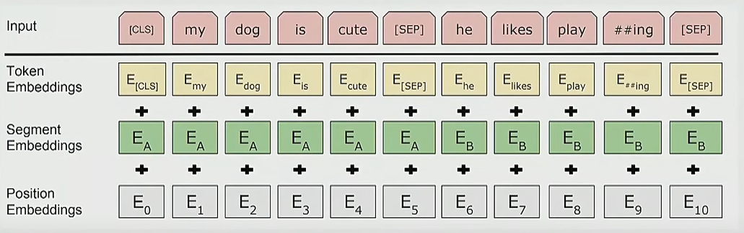
Input Representation

Slide 10
How it is useful to us?
In our task contextual representation of word is very important
The Temporal Sequence of word in sentence formation is also very important
Relation Between two sentences in text is also very important.

